Slide 1
channel Engagement KPI report
Ramandeep sihra
Financial Systems assistant
Star Media Interview Presentation Task Osterley, 09.01.2020

Slide 2
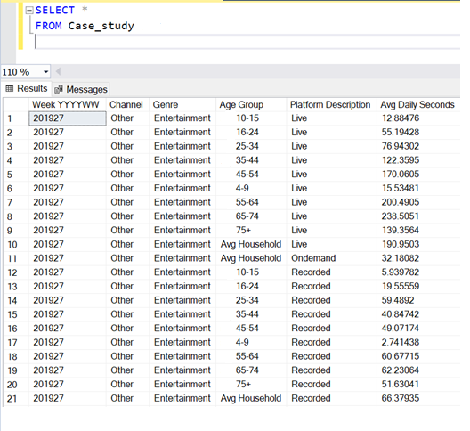
Outline
Definition
Customer Behaviour
Channel Viewings
Pay Vs Free Channel Viewings
Genre Viewings
Age Group Viewings
Platform Viewings
Scorecard For Customer Engagement Team
Findings

Slide 3
Definition
I was asked to produce a KPI Report for the Channel Engagement Team so they can understand the performance of channels within their portfolio.
Pie and bar charts were extracted from the data to look at trends. This can help the team achieve their aim and objectives and guide their next steps.

Slide 4
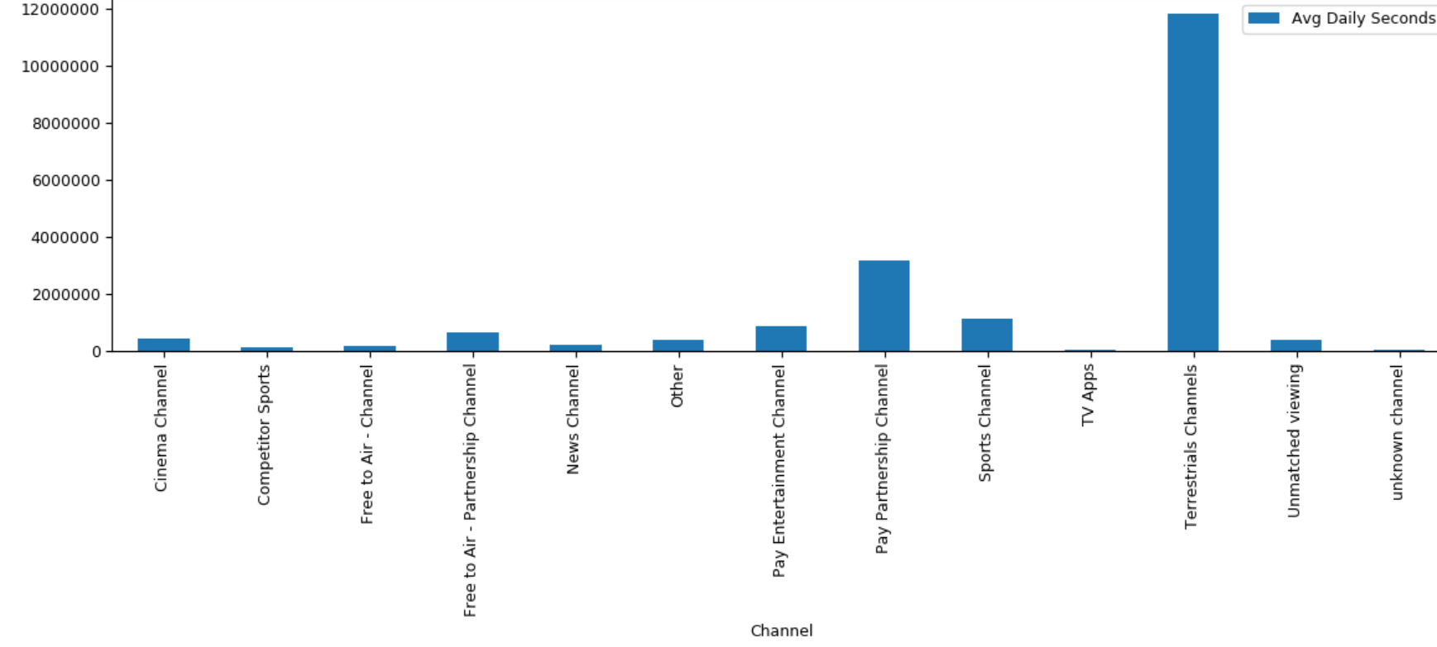

Customer Behaviour- Channel VIEWINGs
Star Media’s most popular channels according to the average daily viewings are terrestrial channel and Pay Partnership channels.
The least popular channels are the unknown channels and TV Apps.
From the bar chart we can see that Star Media has a scope for improvement to increase channel viewings.
Notes:
Star Media’s most popular channels according to the average daily viewings are terrestrial channels and Pay Partnership channel. This is because terrestrial channels are the free channels provided to customers such as BBC. Increase in the Pay Partnership channel can be due to increased subscriptions and incentives.
The least popular channels are the unknown channels and TV Apps. From the bar chart we can see that Star Media has a scope for improvement so we can increase the amount of viewings from other channels.

Slide 5
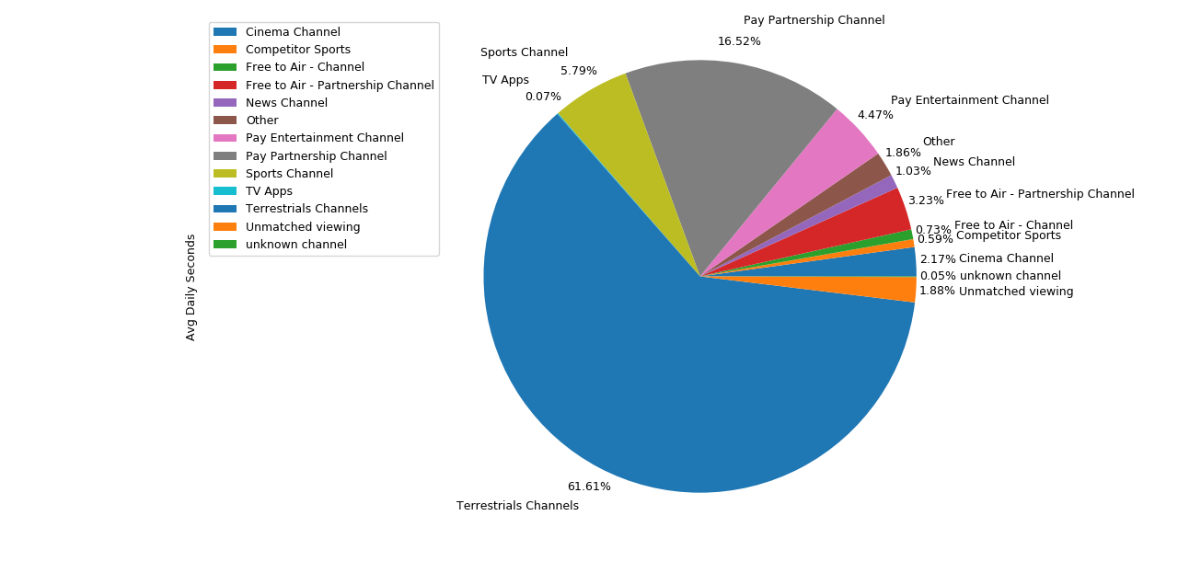
Customer Behaviour- Pay VS FREE Channel Viewings
Surprising results- Free to air channels have popularity compared to Terrestrial channels.
Free to Air channels provides 250 extra channels that are free for customers yet it shows be be one of the least popular channels amongst customers.
Notes:
Pay Partnership Channel is also popular because Star Media members have access to channels such as BT sports and virgin channels and vice versa. It is surprising to see from the results that Free to Air channels have lower results compare to the terrestrial channels since Free to Air channels are terrestrial channels plus 250 channels that are free to Star Media customers such as +1 channels, shopping channels and film channels.

Slide 6
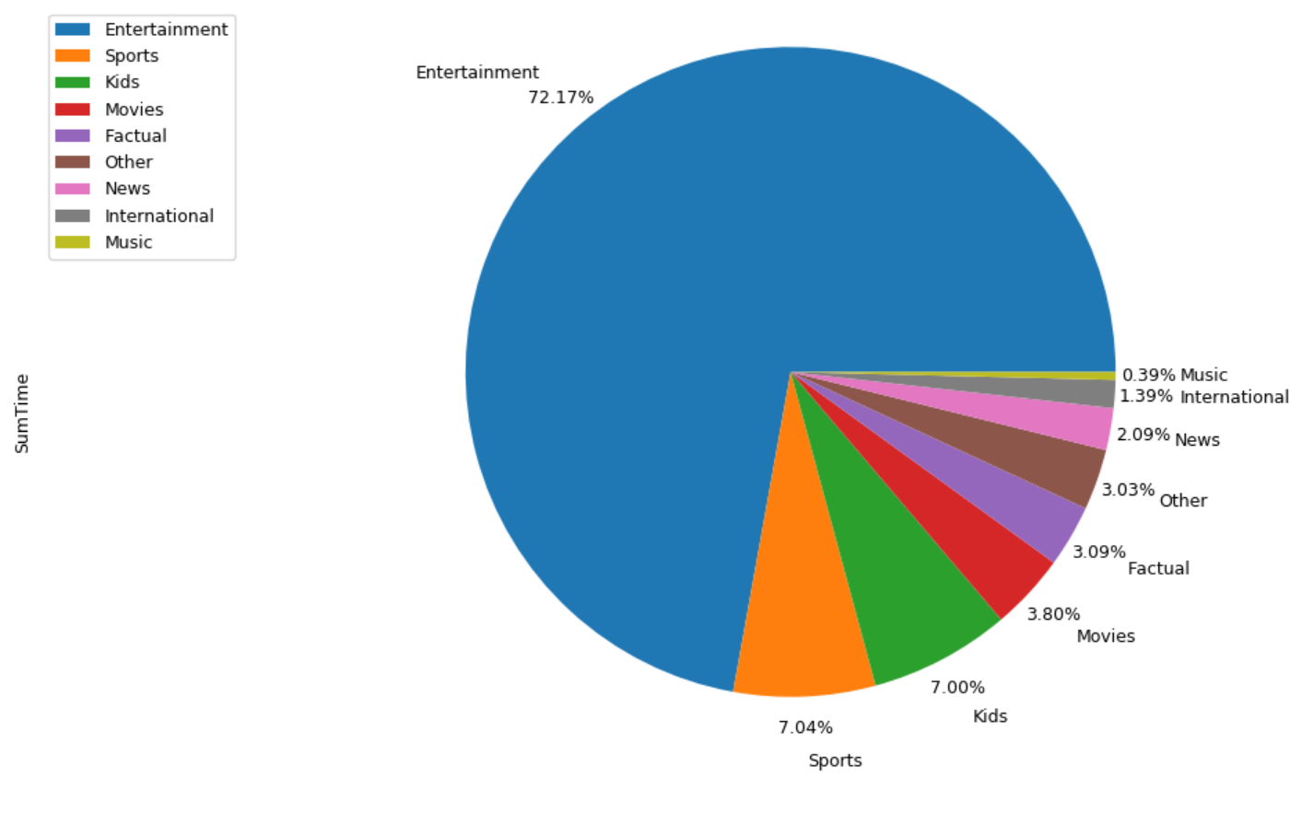

Customer Behaviour- Genre Viewings
Entertainment is by far the most popular channel genre amongst customers.
The least popular genres amongst customers are music and international.
Notes:
Entertainment is by far the most popular channel genre amongst customers. This is because Star Media offers a large range of entertainment channels for example Star Media living, Fox, Universal.
International genre is one of the least popular genres as programmes can be in a foreign language which may be difficult for customers who only speak English to understand.
Music is the least popular genre, this is because music videos can be easily realised on sites such as Youtube where they are easily accessed on remote devices rather than having to wait for new realeses to be seen on the channels. Customers can easily search online for specific music videos instead of having to wait for specific programmes to watch or record. Customers may prefer to listen to music rather than watching music videos, so they may download music to their phones or use Spotify to listen to music.

Slide 7
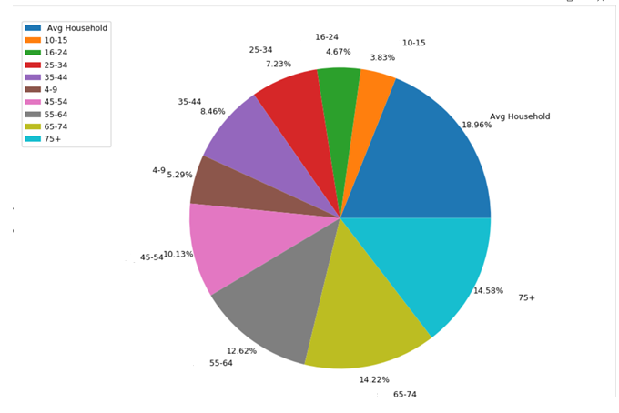
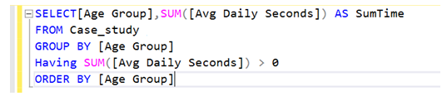
Customer behaviour- Age Group viewings
Star Media caters to a vast range of audiences for the ages of 4+.
The highest number of viewings per sec:
Avg Household (18.96%), 65-74 (14.22%) and 75+ (14.58%).
The lowest number of viewings per sec: 10-15 (3.83%), 16-24 (4.67%) and 4-9 (5.29%)
What are the peak times during the week channels are mostly viewed per age group?
Notes:
Star Media caters to a vast range of audiences for the ages of 4 and above.
We can see that the highest number of viewings per second are for the Avg Household, and the age ranges 65-74 and 75+. Customers belonging to age ranges 65-74 and 75+ belong to a ageing population where they are retired and have more time to watch TV. Avg households have a mixture of age ranges do friends and families may watch programmes together hence the reason why this group has a high number of viewings.
The lowest number of viewings per second are for the age ranges: 10-15 , 16-24 and 4-9. These are mostly preschool- high school children who are in school part/full time and may not be able to watch much TV until weekends.
Customers belonging to are groups 25-34 and 35-44 are either in part time/full time work which could also be the reason why veiwings are lower for this age range.
What are the peak times during the week channels are mostly viewed per age group?– the data set provided did not include viewing times; their inclusion could reveal a relationship between age groups and peak viewing times during the week(s) that helps understand customer behaviour and define a marketing strategy, which in turn can lead to increased viewings.

Slide 8
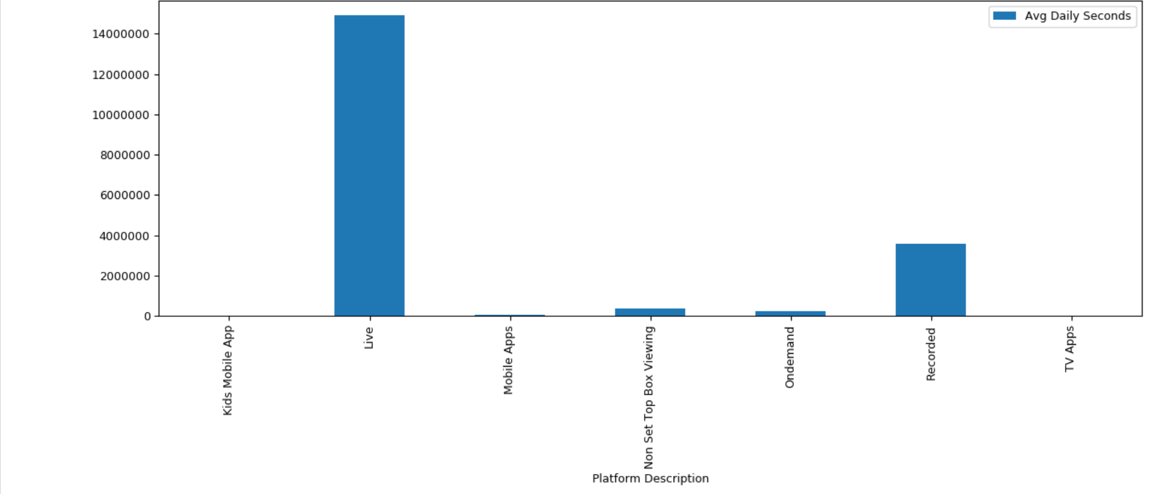

Customer Behaviour- Platform VIEWINGs
Star Media’s most successful Platforms come from live and recorded Platforms.
Customers enjoy watching they favourite programmes and movies on the day it is broadcasted.
For those who are working or busy, customers may record programmes on their favourite channels.
Star Media least popular platforms according to customers are TV Apps and Kid apps.
Notes:
Star Media’s most successful Platforms come from live viewings. Recorded platforms are also popular amongst customers so they do not miss their favourite programmes.
The least popular platforms are the Kids Mobile Apps and TV Apps. Kids may have restricted or no access to smart phones and tablets and therefore we can assume this is the main reason why kid mobile apps is not a popular platform.
Most customers may have to pay extra for TV Apps such as Netflix, Amazon and youtube which could be the reason why this is not popular with customers as they will have to pay extra costs on top of their Star Media subscriptions.

Slide 9

Scorecard For customer engagement team

Slide 10

Findings
Star Media provides customers with various entertainment channels, the most popular being terrestrial and pay partnership channels.
The most popular genre amongst customers is entertainment. The lease popular genre amongst customers are music and international genres.
Avg Household , 65-74 and 75+ are the highest viewing age groups. The lowest number of viewing age groups are 10-15, 16-24 and 4-9.
Live and recorded platforms are the most used platforms by consumers. Kids mobile Apps and TV app platforms are the lowest used platforms.

